Slide 1
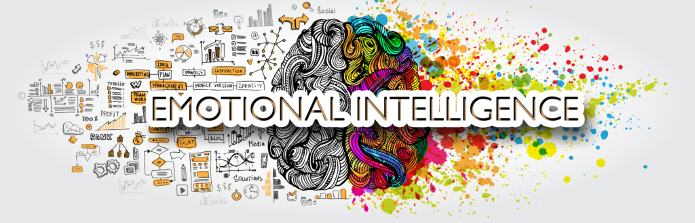
Introductory Workshop for Leaders on Emotional
Intelligence (EI)
https://whiteraycoaching.com/emotional-intelligence
Presenter: Ashley Eskel
Notes:
Instructor note: Though this course is primarily intended to be taught virtually, feel free to pass out learners guides at the beginning of the course in order to provide an additional means of communicating the information if taught in person. Be sure presentation can be clearly seen and heard by all areas of the room.

Slide 2
Welcome!
I am so excited you’ve chosen to join our first workshop on Emotional Intelligence! While we wait for others to join, please complete the following:
Find the chat function on the bottom of the Webex.
Using the chat, let us know who you are, what your role is with our organization, and what you know about emotional intelligence.
If you don’t yet know anything about EI, don’t worry! That’s why we are here!
Notes:
Instructor Note: Leave this screen up 20 minutes prior to start time. Welcome people as they join and ensure they can both hear you and see the screen. Next, ask each member as they join to follow the directions on the screen by opening chat and letting the class know who they are, what their role is, and what they know about emotional intelligence.
Start class on time, using the ice breaker to allow a few minutes for last minute stragglers to join.
Instructor: Introduce yourself, including who you are, your role in the organization, what led you to teaching this course (personal connection, education, etc). Next, begin reading out responses from the chat, encouraging colleagues to continue sharing what they know about EI as you read through the feed. Use this ice breaker up to 10 minutes past start time to ensure everyone has joined.

Slide 3
Agenda
Defining Emotional Intelligence
Why Train Leaders in Emotional Intelligence?
EI Tools Already in Practice
Implications to Consider
Next Steps
References and Resources for Continued Education
Notes:
Instructor says: Let’s first start by going over our agenda for today’s class. Now that we’ve talked about each of you and what you know about emotional intelligence, let’s first define what emotional intelligence is. We will then discuss why leaders should be trained in EI, what tools you may already be familiar with that can help identify your own skillset, and also implications to consider once you’ve learned how powerful EI can be. Last, we will talk about next steps for you to consider in your own EI journey and I will also welcome any questions at the end.
I will ask occasionally for you to share your thoughts in chat or I may ask that you come off mute to talk to the class. This is a judgement free zone and is intended for us all to learn together. We will primarily use chat to communicate so please keep all lines on mute unless otherwise instructed. Now that our agenda and housekeeping is covered, let’s get started!

Slide 4
Defining Emotional Intelligence (EI)
According to Sir John Whitmore, “emotional intelligence can be described as interpersonal intelligence or, even more simply, as personal and social skills. Goleman and others have defined many competencies, including self-confidence, empathy, adaptability, and being a change catalyst, which can be grouped neatly into four domains: self-awareness, self-management, social awareness, and relationship management. That sounds straightforward enough and all of us combine these skills to some degree” (2017, p. 41).
Emotional intelligence is "the ability to perceive and express emotions, to assimilate emotion in thought, to understand and judge with the help of emotions and to regulate one’s own emotions and others” (Hahn, 2012, p. 745).
Notes:
It could be considered common knowledge that generally, leadership requires a certain sense of empathy, awareness, and self-management, yet many organizations fail to appropriately address the need for high competence within this skillset. The concept of emotional intelligence was first academically introduced in a doctoral thesis in the U.S., in 1985, by Wayne Leon Payne, Ph.D. at the Union Institute in Cincinnati. Payne did not create waves in the field of leadership, yet he introduced a new concept that later changed existing theories about leadership, the role of management, and how a manager interacts with those they lead. In 1995, the article "What's your EQ?" by Daniel Goleman appears in "Time,” changing the core ideas of traditional leadership and eventually introducing emotional intelligence as a core set of competencies vital for a leader to be effective and inspirational (Hahn, 2012, p. 744-745).
According to Sir John Whitmore, “emotional intelligence can be described as interpersonal intelligence or, even more simply, as personal and social skills. Goleman and others have defined many competencies, including self-confidence, empathy, adaptability, and being a change catalyst, which can be grouped neatly into four domains: self-awareness, self-management, social awareness, and relationship management. That sounds straightforward enough and all of us combine these skills to some degree” (2017, p. 41). Yet why are these skills integral to effective leadership and what effects does this approach have on employee retention and engagement? As it turns out, Goleman’s concept has been widely accepted by a variety of organizations across the globe, introducing emotional intelligence as a core component of being a leader.
Emotional intelligence is "the ability to perceive and express emotions, to assimilate emotion in thought, to understand and judge with the help of emotions and to regulate one’s own emotions and others” (Hahn, 2012, p. 745). The introduction of this theory helped the business world better understand that the success of a person largely depends on emotional intelligence, acknowledging that besides intellect, an employee needs other qualities as well, such as self-awareness, self-management, social awareness, and relationship management, ultimately meaning an increased emotional competence (2012, p. 745). At its core, “emotional intelligence is the ability to relate to others from a paradigm of trust, rather than one of fear,” which is essential for a leader in any industry (Whitmore, 2017, p. 40).

Slide 5
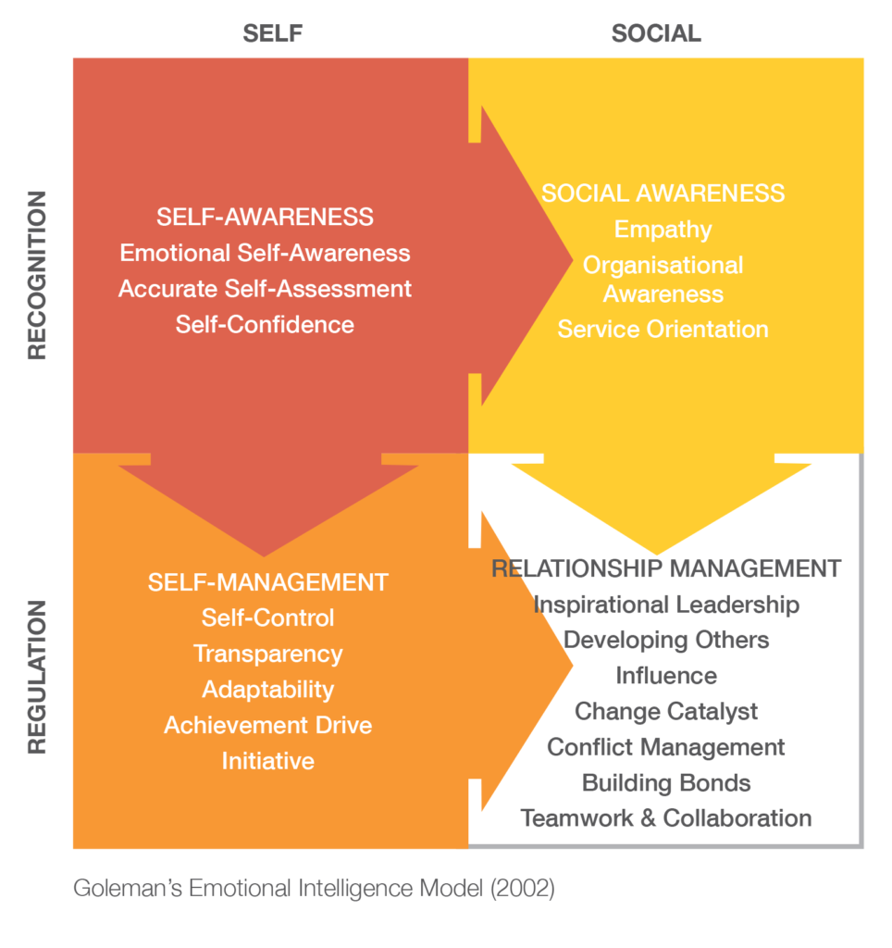
Goleman’s Model
Self-Awareness: involves understanding one’s own emotions, strengths, weaknesses and drives and being able to identify these within oneself.
Self-Management: means not only having an awareness of one’s emotions and traits but being able to grasp and control those urges as well.
Notes:
Daniel Goleman’s five domains of emotional intelligence (EI) can be broken down into the 4 quadrants mentioned. To understand this theory, basic definitions of each quadrant should first be considered. First, self-awareness involves understanding one’s own emotions, strengths, weaknesses and drives and being able to identify these within oneself. (Hicks, 2008, p. 18). In recognizing the impact of one’s own emotions, those who practice self-awareness use their “gut sense” to guide decisions, practice accurate self-assessment in knowing one’s strengths and weaknesses and have a sound sense of self-worth and capabilities (Macaleer, 2002, p. 11). D.D. Warrick (2019), author of “Leadership Illusions,” writes that there is a need for more self-aware leaders, pointing to organizations to develop professionals to provide training and coaching in preparing leaders to be more self-aware. Further, a variety of studies have reported the impact of unaware leaders on employee motivation, morale, and health, with support that “caustic, abrasive, and overbearing bosses may be taking years off their employee’s lives (Warrick, 2019, p. 6).
Second, self-management means not only having an awareness of one’s emotions and traits but being able to grasp and control those urges as well. Leaders must find ways to control their moods and impulses and even channel them into useful tools, especially when setting the example for subordinates (Hicks, 2008, p. 18). This competency largely requires the ability to not only manage one’s emotions, but to also remain motivated when encountering triggers. Leaders who practice self-management further practice transparency in remaining honest and trustworthy, demonstrate adaptability in handling change, and possess the readiness to act and seize opportunities. In fact, these leaders are often insightful, creative, dynamic, and are capable of continuous improvement (Baesu, 2018, p. 73). This competency further incorporates optimism on behalf of the leader and a desire to attain achievement, where they demonstrate the drive to improve performance to meet their own standards of excellence (Macaleer, 2002, p. 12).
Let’s take this to chat. Do you believe that you are someone who is self aware and able to manage your emotions? How do you do so? What do you feel is the biggest struggle faced by leaders when learning to be self-aware? Please share your thoughts and chat and I will share these outloud.
Instructor adds in personal anecdote or experience and then reads through the chat to share the ideas of others.
Instructor says: Great! Thanks all for sharing! Let’s explore the last 2 components of Goleman’s model.

Slide 6

Goleman’s Model
Social Awareness: considered the ability to recognize and understand the emotions of other people, which is essentially thoughtfully considering the feelings of another, a concept more commonly referred to as empathy.
Relationship Management: relates to managing relationships within the workplace, by establishing appropriate social skills and recognizing that every member of a team can be a positive contributor if a leader takes the time to understand each person
Notes:
Social awareness is considered the ability to recognize and understand the emotions of other people, which is essentially thoughtfully considering the feelings of another, a concept more commonly referred to as empathy (Hicks, 2008, p. 18). Empathy involves sensing the emotions of another, being able to view the situation through their perspective, and taking an active interest in what is needed. Additionally, those with skills in social awareness also demonstrate organizational awareness, where they are comfortable within decision networks and politics at an organizational level (Macaleer, 2002, p. 12). Social awareness can also apply to recognizing and meeting the needs of clients and customers, though the intended audience of this literature review is leaders and those they lead.
Relationship management is the fourth quadrant of EI, which relates to managing relationships within the workplace, by establishing appropriate social skills and recognizing that every member of a team can be a positive contributor if a leader takes the time to understand each person (Hicks, 2008, p. 18). A leader who does well demonstrating relationship management can influence others through effective tactics of persuasion, demonstrates conflict management skills and being a change catalyst, where they may initiate, manage, and lead in a new direction. Further, these leaders are inspirational in how they use a compelling vision to motivate others, leading to the cultivation and maintenance of bonds and relationships (Macaleer, 2002 p. 12). To be effective, it’s instrumental for leaders to be skilled at listening to others, building relationships shouldered on trust, and involving and engaging others (Warrick, 2019, p. 7).
Let’s take this to chat again! Let us know in the chat: What sets a great relationship apart from just a “good one?” Think about not just your personal relationships, but also relationships with your coworkers as well. Let’s see what you have to share!
Instructor reads several ideas shared in the chat.
Great all! Thanks for sharing! Research shows that “one of the main factors that sets great relationships apart from merely good ones is the depth of emotional intimacy. There are, of course, other factors that contribute, but authenticity, vulnerability and deep emotional connectedness are right up there at the top of the list” (Bloom, 2011). While it may seem a stretch to consider the connection between a leader and subordinates as a relationship, that is exactly what it is. In the workplace, we often build bonds with the people who we spend most of our days with. In my own experience, some of my coworkers have become some of my closest friends in part due to the experiences we have had together. Here is where the importance of emotional intelligence plays a role for a leader in terms of these relationships.
As a leader or subordinate, “connecting to ourselves on a feeling level is, for many of us, much easier said than done, but with practice, we can learn the language of emotions and become skilled at recognizing feelings when they arise, identifying them, experiencing them, and ultimately, honoring them through our communications and/or actions” (2011). In being able to recognize feelings as they arise as a leader, we can connect to our staff in a way that they not only trust our authenticity but feel as though they are safe in discussing their emotions and issues at hand. This not only prevents issues from getting out of control or past the time to reconcile, but also provides hindsight before an issue becomes just that.

Slide 7

Why Train Leaders in EI?
The presence of emotionally intelligent leaders:
  Creates an organizational climate which contributes to the development of employees.
  Fosters engagement by stimulating employees to want to contribute to the organization’s objectives.
  Encourages individuals to lead with a focus on motivation, empathy, and inspiring others through communication
Notes:
Now that we’ve covered what EI is, let’s talk more about why we should train leaders to be emotionally intelligent. In a peer reviewed article by Professor Todorut Amalia Venera (2019), “one of the most important factors in creating an organizational climate that contributes to the development of the employees and stimulates them to contribute fully to the achievement of the organization's objectives, is the presence of emotionally intelligent leaders” (p. 160). In tandem with this statement, leadership can be defined as the process of influencing and motivating others in the direction of achieving common goals. According to Venera (2019), the leader's role has a strong emotional component, hence need for emotional competences (p. 160).
The International Journal on Leadership published an article in 2019 entitled “Role of Emotional Intelligence in Effective Leadership,” acknowledging the notion that EI plays a vital role in the effectiveness of leaders and has become an emerging construct which has attracted not only practitioners and academics, but also the domain of psychological research. Further, “EI has become increasingly prevalent in the selection, training, and development processes of organizations,” with findings that there “exists a significant relation between a leader’s level of EI with work performance of subordinates” (Yadav, 2019, p. 27).
Venera (2019) speaks to the fact that the role of the leader to be emotionally responsible is fundamental to leadership practice. In establishing that emotional intelligence manifests itself via skills of self-awareness and self-control of emotions, as well as social skills, it should further be notated that being a leader is primarily about motivation, empathy, and inspiring others through the ability to communicate emotionally. In fact, Venera (2019) argues, “no one will be motivated, inspired, excited and even loyal to the manager if he is not capable of emotional connection” (p. 160).

Slide 8
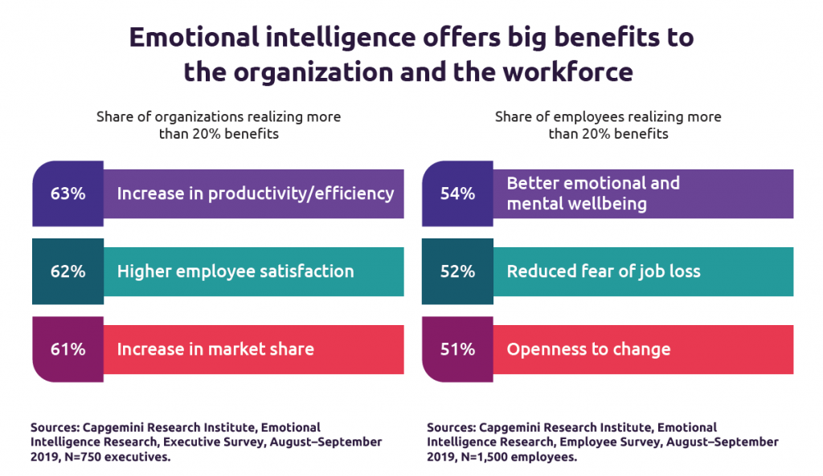
Why Train Leaders in EI?
Studies show that EI is a better predictor of life success than IQ
  “IQ gets you hired, but EQ gets you promoted.”
  Research has proven that group decision making is superior to one individual’s mindset
    Collective EI is what sets high-performing teams apart from average performing teams, according to Goldman (2002, p. 58).
Notes:
Robert Hicks (2008), clinical professor of organizational behavior at the University of Texas, wrote that “recent research has found that effective leaders consistently have a high level of EI and that EI is a better predictor of life success (not only occupational attainments but also satisfaction with life, friendships, and family) than is intelligence quotient (IQ). Such evidence has led to this saying: “IQ gets you hired, but EQ [emotional quotient] gets you promoted.” This is not to say that IQ and technical skills are irrelevant—of course they matter. But they may be viewed as threshold capabilities—that is, they are necessary for attaining high-level managerial positions” (p. 18).
In the article, “Emotional Intelligence: How Does it Affect Leadership,” authors William D. Macaleer and Jones B. Shannon (2002) attempt to link the idea of EI and why it should matter to the business world. According to Macaleer and Shannon, “there is increasing evidence in the business community and elsewhere that some of the issues with the X-generation and Y-generation folks integrating into organizations are the result of underdeveloped emotional intelligence. They may not have the experience, maturity, or good mentoring and focus necessary to develop these skills at their young ages and, instead, tend to rely on technical or specifically acquired skills to propel them through the minefields of organizational existence. This sometimes is not enough to carry a person, resulting in individual and organizational dysfunction” (p. 10).
If there is already an identified lack of emotional intelligence development, then there is clearly a case for supporting EI education in the workplace, especially for leaders who can cascade these learned behaviors down the line. Associate Professor Camelia Baesu (2018) from the University of Suceava, Romania wrote, “leaders play an absolute emotional role, having the maximum capacity of influencing all members’ emotions in modern organizations. In performing organizations there must be an encouraging emotional bond between the leadership representatives and employees. The performance or downfall in an organization depends significantly on the leader’s capacity of channeling emotions in a positive or negative direction” (p. 73). The impact of personal behavior is far reaching, with Goleman arguing that a leader's behavior creates a culture of either dissonance or resonance. Goleman’s research concludes that “where there is resonant leadership there is also a sustainable high level of excellence in business performance” (Macaleer, 2002, p. 11).
In the last few decades, research has proven that group decision making is superior to one individual’s mindset, with one exception. According to this research, “if the group lacks harmony or the ability to cooperate, decision-making quality and speed suffer. . . even groups comprising brilliant individuals will make bad decisions if the group disintegrates into bickering, interpersonal rivalry, or power plays” (Goleman, Boyatzis, & McKee, 2002, p. 56). A leader holds the foundation in that emotions are contagious, and people will naturally pay attention to the actions and behaviors of a leader, leaving a leader responsible for setting the tone and helping to create the group’s emotional reality (2002, p. 56). If a leader is not emotionally intelligent and not cascading these behaviors to those they lead, a team is likely to stray far from their goals and motivations. Collective EI is what sets high-performing teams apart from average performing teams, according to Goldman (2002, p. 58).
According to Joseph Raelin (2003), “compassionate leaders do not seek to control or to awe others because of some unmet ego needs. . . they seek to elevate others so that the whole community can benefit. What makes them special is not necessarily their own elevation to a high state of development but an interpersonal commitment to the dignity of others. They recognize the potential contribution of each member of the community, no matter what his or her position or status.” As a compassionate leader, there are many ways to foster emotional intelligence with a team, like “developing emotional awareness norms, such as taking time to get to know each other to increase interpersonal understanding and to ensure equal participation so that all perspectives can be considered. Emotional regulation norms include setting ground rules for conversational courtesy, providing emotional support to help team members, creating outlets to express emotions, and developing a positive communication environment” (Levi, 2017, p. 118).
Let’s take this to chat. I want to hear from all of you: Do you see value in becoming more emotionally intelligent? How do you think your team may react to a leader who is more empathetic and works to inspire and motivate by better identifying the emotions of others? Do you recognize these qualities in yourself already or maybe even a leader you look up to now? Let us know in the chat!
Instructor reads through chat, encouraging the class to continue the conversation even though not all answers may be read.
Excellent! I appreciate the participation today! Let’s now explore some of the tools you have access to in order to help identify emotional intelligence. Drop a yes or no in chat if you’ve ever heard of or have used any of these tools before.

Slide 9
EI Tools Already in Practice
Commonly used tools: Myers Briggs, 16PF, and BarOn Eq-1
To change the application to a determination of emotional intelligence would be little to no disruption to current practices where these tools are already in use.
Mindfulness: can help leaders develop their self-awareness, which will in turn help them understand how they fit into organizational culture and how they can create a more balanced leadership style and develop greater self-regulation (Kaoun, 2019, p. 205).
Notes:
In addition to building a clear connection between effective leadership and the utilization of EI, it should be noted that there are several tools already well known to the business world that help provide insight into how a person communicates and makes decisions, such as Myers Briggs, 16PF, and BarOn Eq-1. According to research, “a common approach is to use a combination of these tools to determine the level of competency and emotional intelligence skills of high performers. . . These can then be benchmarks for hiring, promotion, and career-development activities and developing competency models for other positions” (Macaleer, 2002, p. 16). It’s common enough practice for corporations to utilize one of these methods already, especially upon hiring individuals to determine what type of worker or personality they may be. To change the application to a determination of emotional intelligence would be little to no disruption to current practices where these tools are already in use.
Mindfulness is another practice that has recently been trending in the business world, receiving praise from business and development professionals who believe in this practice to unlock the full potential of a learners’ EI (Kaoun, 2019, p. 200). One such professional, Tarek M. Kaoun (2019), argues that teaching EI from a cognitive perspective only contributes very little to developing emotionally intelligent leaders. In fact, Kaoun (2019) believes that EI is “predicated on the need to push deeper into our mental and emotional capabilities in order to truly feel, experience, and understand EI. . . we need to push beyond surface” (p. 202). According to Kaoun’s (2019) research, mindfulness can help leaders develop their self-awareness, which will in turn help them understand how they fit into organizational culture and how they can create a more balanced leadership style and develop greater self-regulation (p. 205). Though Kaoun’s (2019) approach is just one way to improve a leaders emotional intelligence skill, it is evidence that the business world is already in tune with practices that can be used to push deeper, helping to create better leaders for the future.

Slide 10
Implications to Consider
In Adam Grant’s (2014) article, The Dark Side of Emotional Intelligence, he explores the idea that “in some jobs, being in touch with emotions is essential. In others, it seems to be a detriment. And like any skill, being able to read people can be used for good or evil.”
“People who use their leadership roles solely to gain formal or informal power are not displaying leadership at all. Rather, they are using their EI to grasp what people want and to pander to those desires to gain personal authority and influence” (Hicks, 2008, p. 18.)
Notes:
Though we’ve established why we should teach leaders to be emotionally intelligent, it should be mentioned as well that EI is powerful and can be used in negative ways as well. In Adam Grant’s (2014) article, The Dark Side of Emotional Intelligence, he explores the idea that “in some jobs, being in touch with emotions is essential. In others, it seems to be a detriment. And like any skill, being able to read people can be used for good or evil.” Emotional intelligence is essentially the ability to recognize, understand, and regulate emotions, which is not only important for a leader on a personal level, but equally as important to consider when interacting with a team built of diverse personalities. In gaining control of one’s own emotional intelligence, as suggested by Grant (2014), it can be used for either good or evil in the way a leader can influence others.
Can you think of examples where a person may use emotional intelligence in a negative aspect? Or can you think of a leader who has exhibited strong EI but in a negative context? Please share in chat your thoughts and I will read a few out loud.
Instructor reads a few examples from the chat and may also insert a personal example here.
When we consider this dark side, too much EI can result in inappropriate behaviors and actions. In considering potential drawback of EI, we can first consider that effective leaders have empathy for others, yet also must be able to make the tough decisions. Overidentifying with others and confusing empathy with sympathy can not only make decisions harder to make but can also ultimately result in inappropriate behavior and decision making (Hicks, 2008, p. 18). Leaders are also charged with having reasonable judgement of character, which leaves the possibility of becoming “judgmental and overly critical about the shortcomings they perceive in others” which may in turn cause to dismiss other people’s insights, making others feel undervalued and once again resulting in inappropriate behavior (2008, p. 18). Being a leader “involves a collective action meant to bring about significant changes, by increasing competence and motivation of all those involved” (Baesu, 2018, p. 77).
Once last implication to consider revolves around the idea that effective leaders are altruistic and focused on the general welfare of the company. According to Hicks (2008), this may be a façade, and “in fact, such leaders may be manipulative, selfish, and dishonest” (p. 18). A leader who is manipulative is overly confident and exerts excessive power in the workplace and may even use their own charisma to promote values they themselves don’t believe in (Baesu, 2018 p. 77). Further, “people who use their leadership roles solely to gain formal or informal power are not displaying leadership at all. Rather, they are using their EI to grasp what people want and to pander to those desires to gain personal authority and influence” (Hicks, 2008, p. 18.)

Slide 11
What’s Next?
Utilize one of the mentioned personality tools to determine how emotionally intelligent you may be.
Consider how to incorporate skill building of EI into your current work atmosphere.
Work with your manager to create an action plan in order to develop these skills further
Stay tuned for additional workshops on developing EI for application in the workspace.
Notes:
We have covered a lot today in a short period of time. I hope that you are able to take something from this workshop to start building your own skillset to become emotionally intelligent, if you may not be already. And if you do find you already have a high level of EI, begin to think how you can properly utilize this skillset in your current role. I encourage use to use one of the tools mentioned to identify your own personality traits and to determine areas of strengths and weaknesses in order to become an even more well-rounded leader. Talk to your manager and develop an action plan to practice and strengthen these skills within your role. Or take a look at the references at the end of this presentation and within your own guide to self navigate emotional intelligence and identify the areas most important and relevant to you.
I want to thank you all for joining this workshop today. The goal was to introduce you to and start the conversation around emotional intelligence. Stay tuned for additional workshops based on developing your EI and successfully applying this skillset into your own career.
At this time, I’d like to open the floor to any questions. Feel free to take yourself off mute and ask or go ahead and put your question into the chat and I’d be more than happy to discuss.
Instructor takes questions until class is satisfied. If questions are not relevant to the group, offer to stay on after class to discuss further.

Slide 12
THANK YOU
Notes:
If there are no more questions, that concludes our time for today. Please make sure to print (or take) a copy of the learner's guide to reference should you need reminders about what we went over in this course. Thank you again for participating and I hope everyone has a wonderful day!

Slide 13
References
Baesu, C. (2018). Leadership Based on Emotional Intelligence in Modern Organizations. USV
Annals of Economics and Public Administration, 18(2(28)), 73–78.
Bloom, L. (2011). The Cost and Benefits of Emotional Honesty. Psychology Today.
https://www.psychologytoday.com/us/blog/stronger-the-broken-places/201112/the-cost-and-benefits-emotional- honesty.
Goleman, D., Boyatzis, R., & McKee, A. (2002). The Emotional Reality of Teams. Journal of
Organizational Excellence, 21(2), 55–65. doi: 10.1002/npr.10020.
Grant, Adam. (2014). The Dark Side of Emotional Intelligence. The Atlantic.
https://www.theatlantic.com/health/archive/2014/01/the-dark-side-of-emotional-intelligence/282720.
Hahn, R.-F., Sabou, S., Toader, R.-M., & Rădulescu, C. M. (2012). About Emotional
Intelligence and Leadership. Annals of the University of Oradea, Economic Science
Series, 21(2), 744–749.

Slide 14
Hicks, R., & Dess, G. G. (2008). A question of leadership: Are there any potential downsides to
emotional intelligence for executives, and if so, what are they? Leadership in
Action, 28(5), 18–24. doi: 10.1002/lia.1264
Kaoun, T. M. (2019). Enhancing Leaders’ Emotional Intelligence: Why Mindfulness? Journal of
Leadership Education, 18(1), 200–212. doi:10.12806/V18/I1/T2
Levi, D. (2017). Group Dynamics for Teams (5th ed.). Thousand Oaks, California: SAGE
Publications.
Macaleer, W. D., & Shannon, J. B. (2002). Emotional Intelligence: How Does it Affect
Leadership? Employment Relations Today (Wiley), 29(3), 9–19. doi:10.1002/ert.10047
Raelin, J. A. (2003). Creating leaderful organizations: How to bring out leadership in everyone.
San Francisco: Berrett-Koehler.
Venera, T. A. (2019). Leadership and Emotional Intelligence. Analele Universităţii Constantin
Brâncuşi Din Târgu Jiu : Seria Economie, 6, 160–166.
Warrick, D. D. (2019). Leadership Illusions: Important Implications for Leaders and Training
and Coaching Leaders. Organization Development Review, 51(2), 6–13.
Whitmore, J. (2017). Coaching for Performance (5th ed.). Boston, MA: Nicholas Brealey Publishing.
Yadav, R., & Lata, P. (2019). Role of Emotional Intelligence in Effective
Leadership. International Journal on Leadership, 7(2), 27–32.

